Slide 1
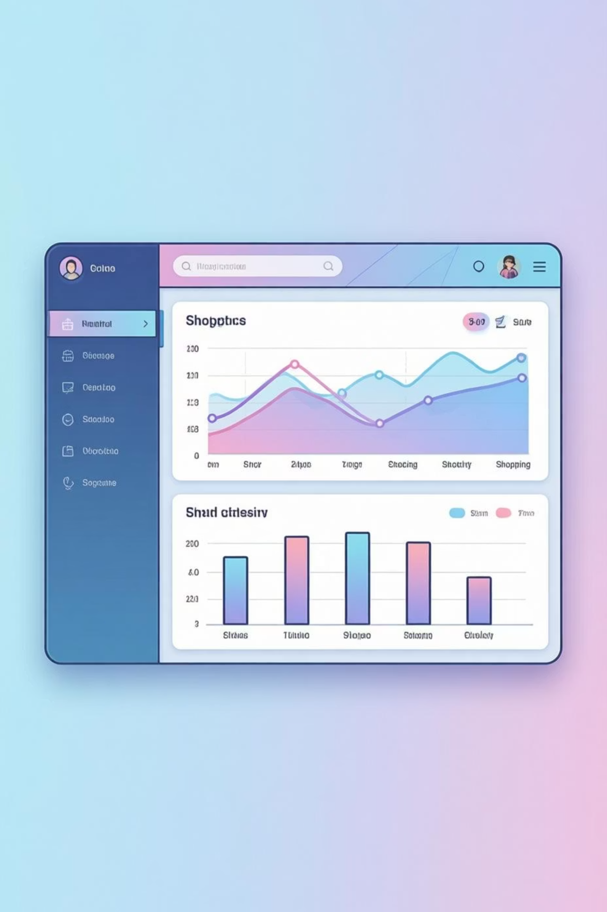
Customer Shopping Behavior Analysis
Analyzing 3,900 purchases to uncover insights into spending patterns, customer segments, and product preferences that drive strategic business decisions.

Slide 2
DATASET OVERVIEW
Understanding Our Data
3,900
18
50
25
Total Purchases
Data Points
Locations
Products
Transactions analyzed across all categories
Features tracking customer behavior
Geographic distribution of customers
Unique items purchased
Dataset includes customer demographics, purchase details, and shopping behavior metrics. Only 37 missing values found in Review Rating column.

Slide 3


PYTHON ANALYSIS
Data Preparation & Cleaning
Initial Exploration
Data Enhancement
Loaded dataset using pandas
Imputed missing Review Ratings using median
Checked structure with df.info()
Standardized columns to snake_case
Generated summary statistics
Identified missing values
Created age_group bins
Dropped redundant promo_code_used column

Slide 4
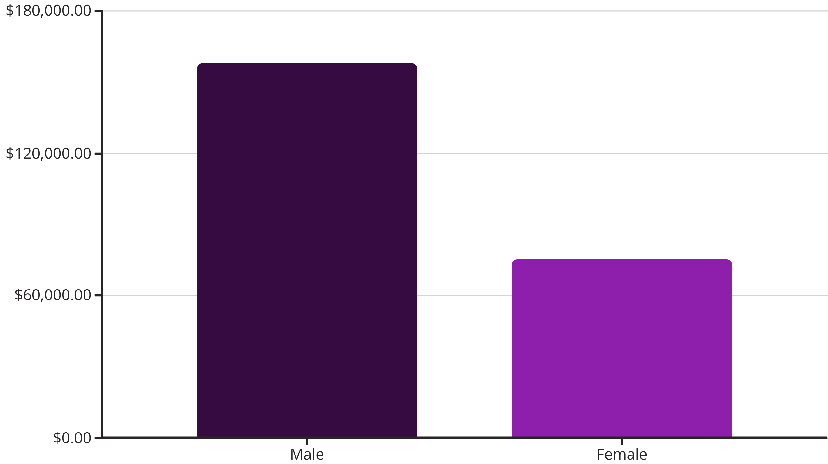
SQL ANALYSIS
Revenue Insights by Gender
Male customers generate 68% of total revenue, representing a significant opportunity to better engage female shoppers through targeted campaigns.

Slide 5
Top-Rated Products Drive Satisfaction
Gloves
Sandals
Boots
3.86 rating
3.84 rating
3.82 rating
Hat
Skirt
3.80 rating
3.78 rating

Slide 6
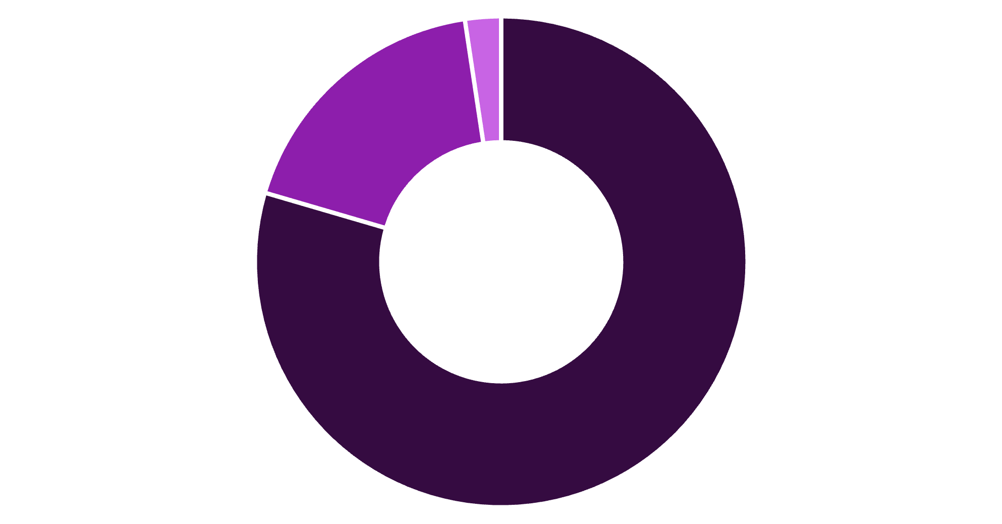
Customer Segmentation Analysis
80% of customers are loyal, demonstrating strong retention. Focus on converting the 18% returning customers into loyal advocates through targeted engagement.
Loyal
Returning
New

Slide 7

SUBSCRIPTION INSIGHTS
Subscription Status Comparison
Subscribers
1,053 customers
$59.49 average spend
$62,645 total revenue
Non-Subscribers
2,847 customers
$59.87 average spend
$170,436 total revenue
Only 27% of customers subscribe. Among repeat buyers (5+ purchases), 958 are subscribers vs. 2,518 non-subscribers—a major opportunity to convert loyal customers.

Slide 8
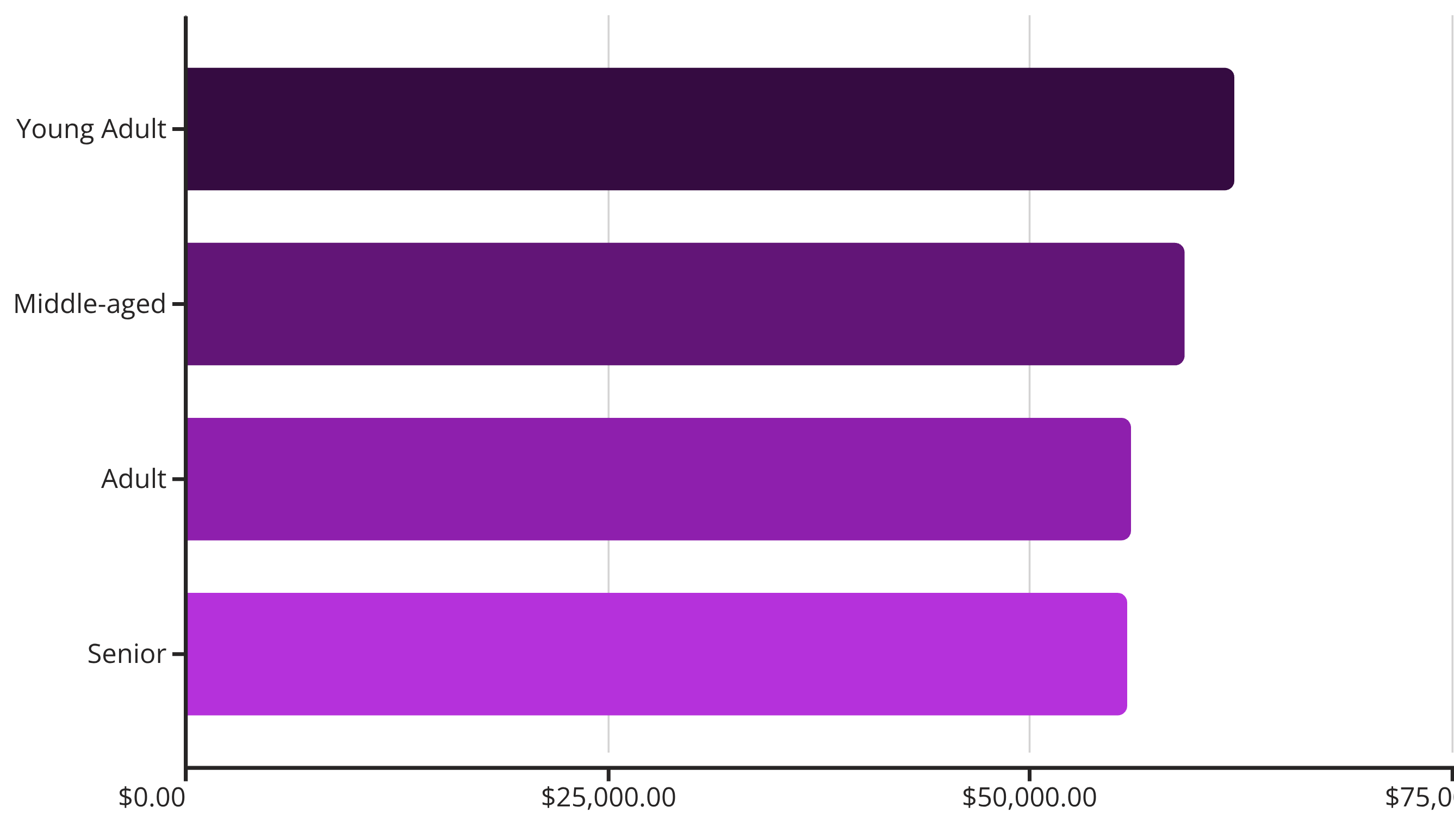
Revenue Distribution by Age Group
Young adults lead revenue generation, followed closely by middle-aged customers. Revenue is relatively balanced across all age groups, suggesting broad market appeal.

Slide 9
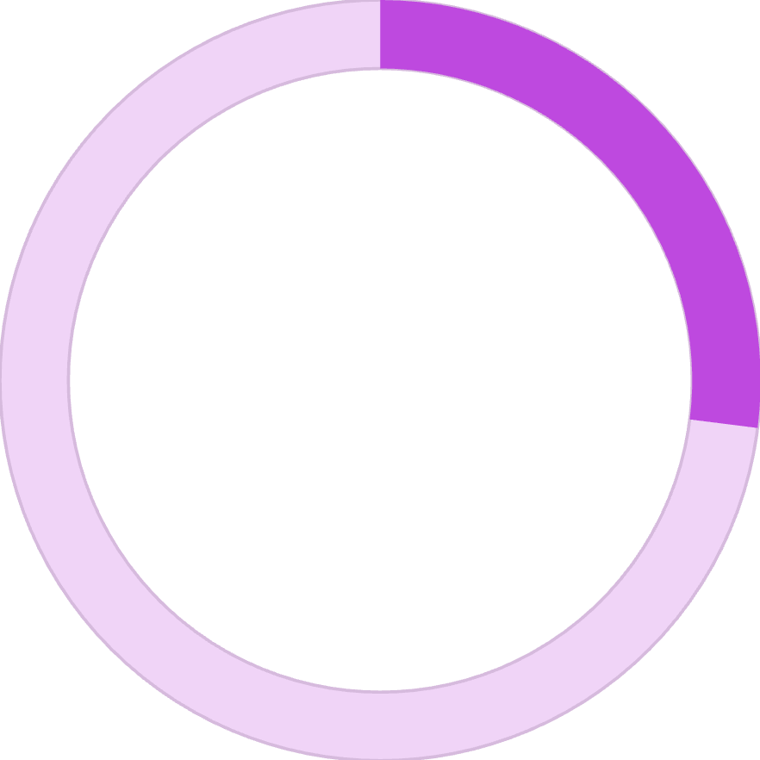

POWER BI
Interactive Dashboard Overview
27%
73%
Subscription Rate
Non-Subscribers
Customers with active subscriptions
Opportunity for conversion
Dashboard provides real-time filtering by subscription status, gender, category, and shipping type. Key metrics include 3.9K customers, $59.76 average purchase, and 3.75 average rating.

Slide 10





STRATEGIC RECOMMENDATIONS
Driving Growth Through Action
Boost Subscriptions
Promote exclusive benefits to convert the 73% non-subscribers, especially among repeat buyers.
Loyalty Programs
Reward returning customers to accelerate their journey into the loyal segment.
Targeted Marketing
Focus campaigns on high-revenue young adults and express-shipping users.
Product Positioning
Highlight top-rated products like gloves and sandals in promotional campaigns.
Review Discount Policy
Balance promotional sales boosts with margin control for sustainable growth.

